Slide 1
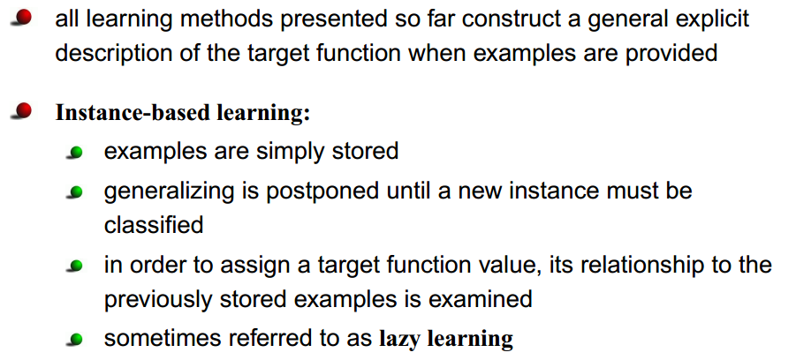
Instance-Based Learning (IBL)
Chapter-8 , Mitchell

Slide 2
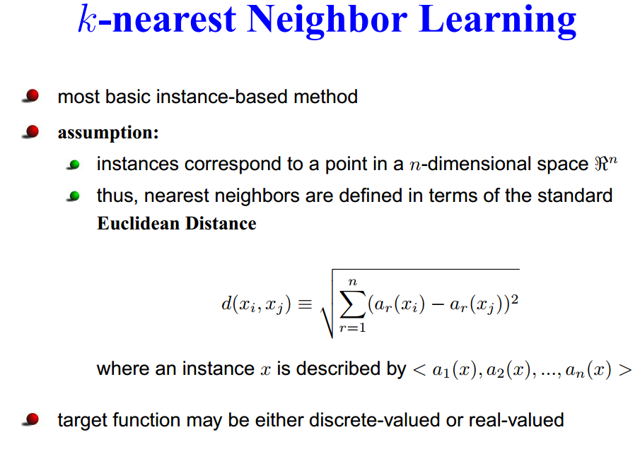

Slide 3
Consider, the case of learning a discrete-valued target function of the
form
Training Algorithm
For each training example <x , f(x) >,
add the example to the list of training_examples
Given a query instance xq to be classified
1. Let x₁ … x_{k} denote the k instances from
training_examples that are nearest to x_{q}
2. Return

Slide 4
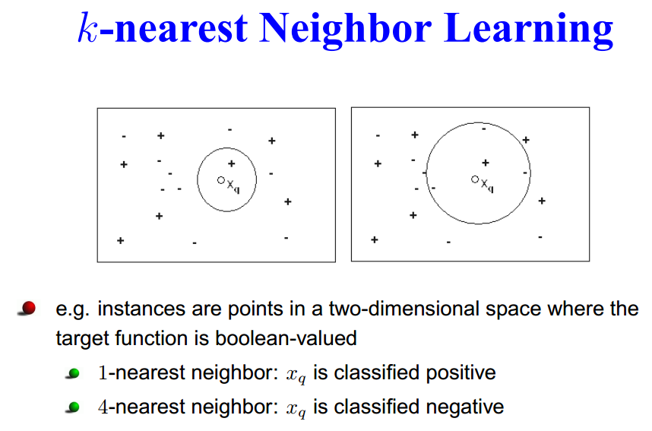

Slide 5
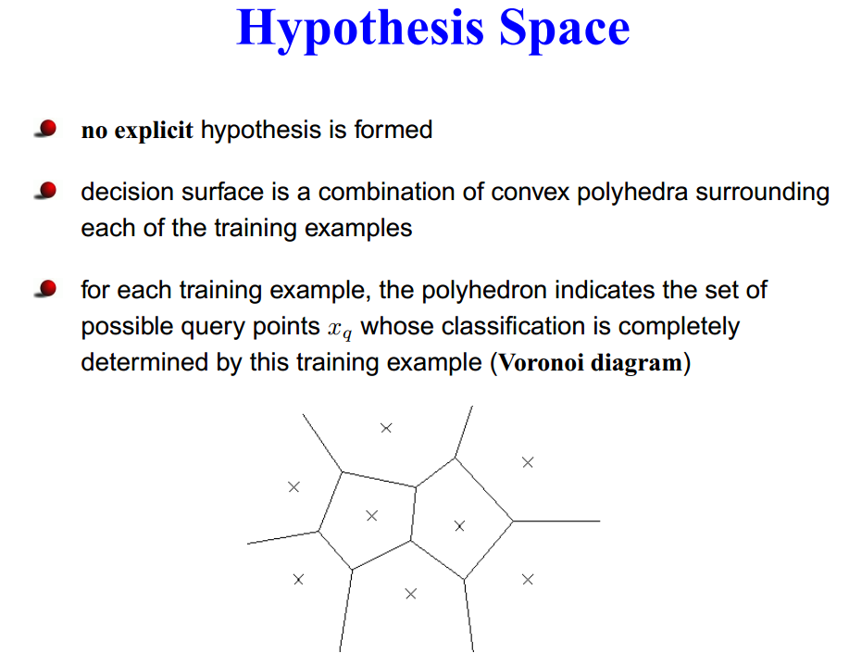

Slide 6
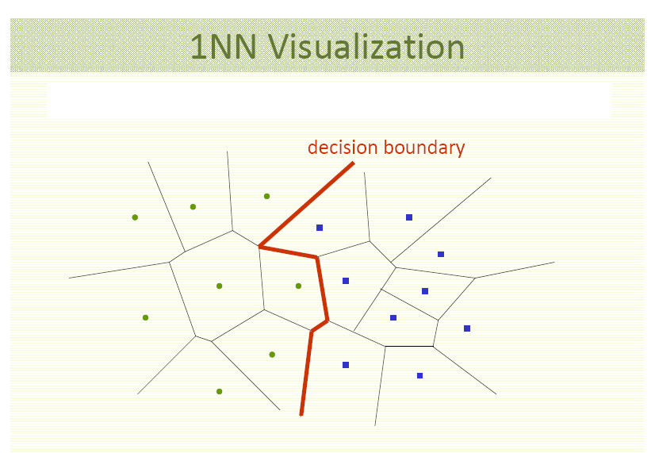

Slide 7
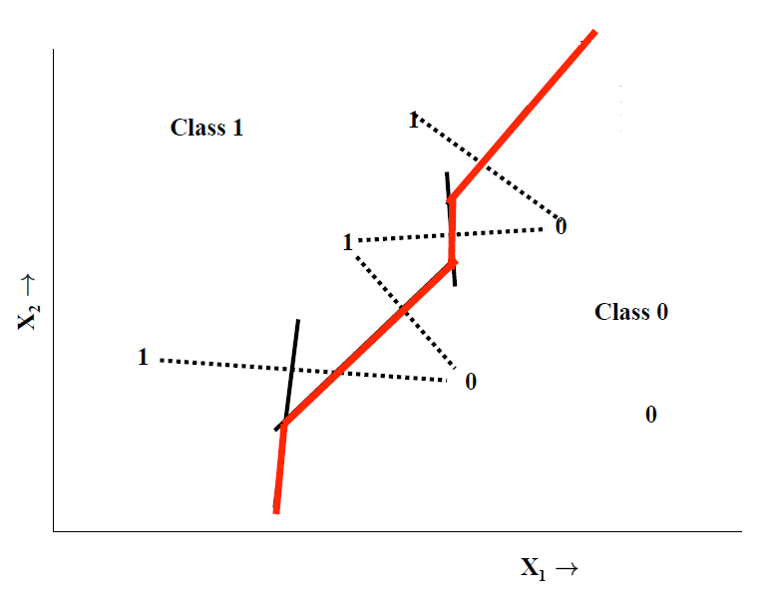

Slide 8
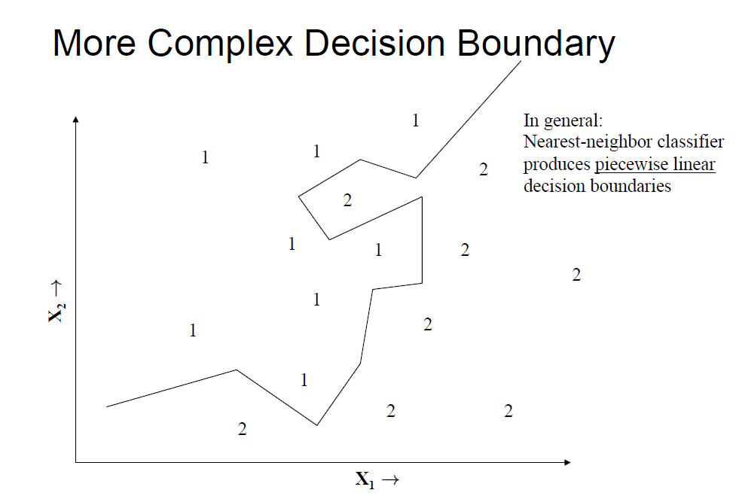

Slide 9
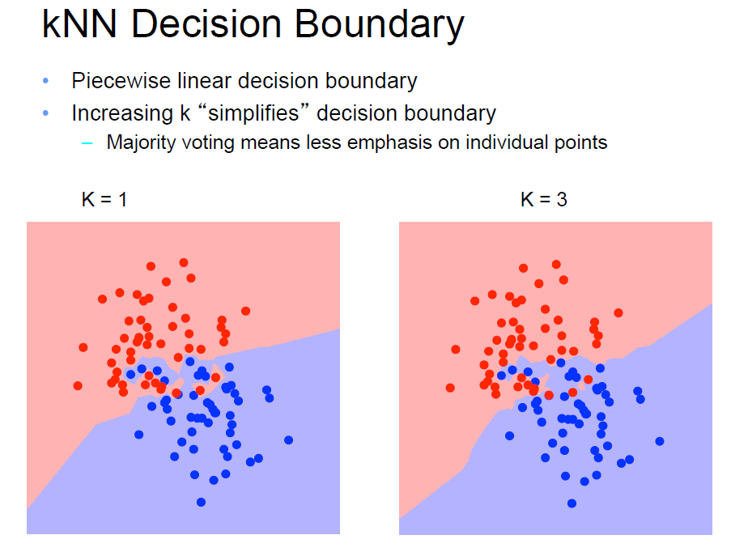

Slide 10
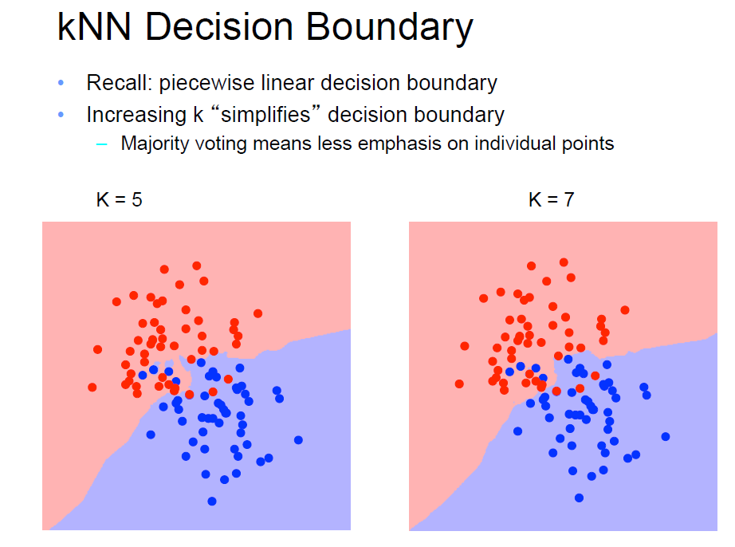

Slide 11
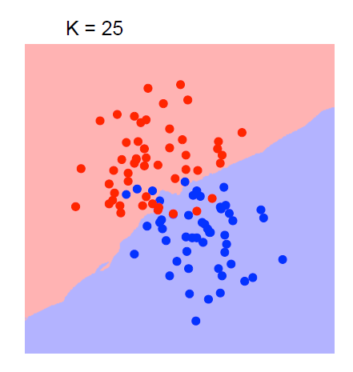

Slide 12
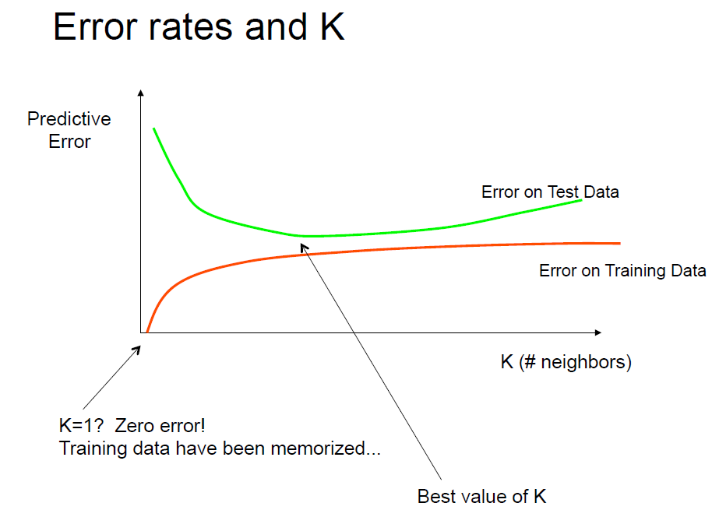

Slide 13
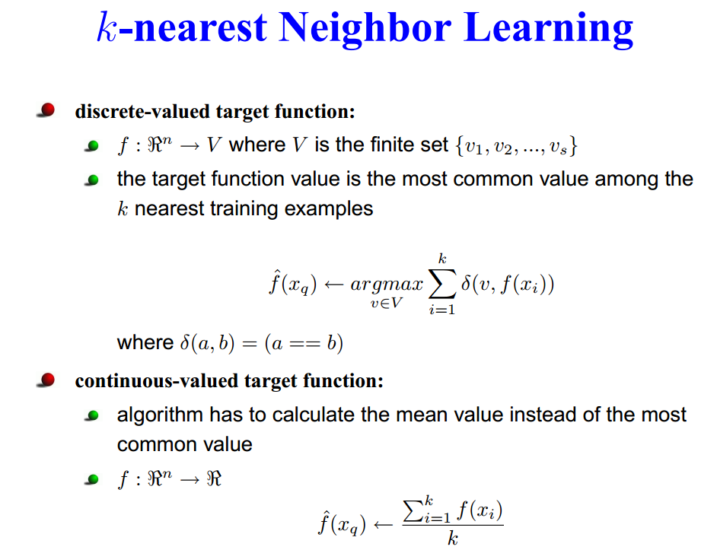

Slide 14
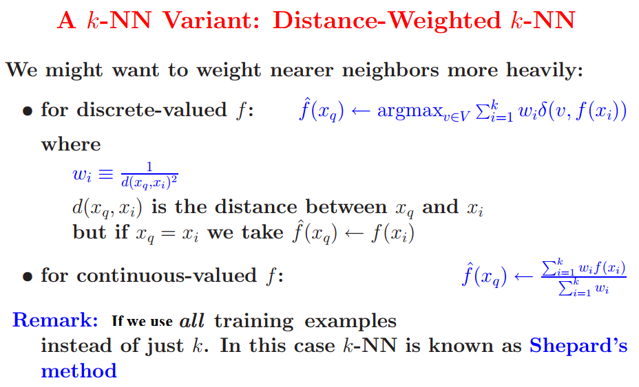

Slide 15
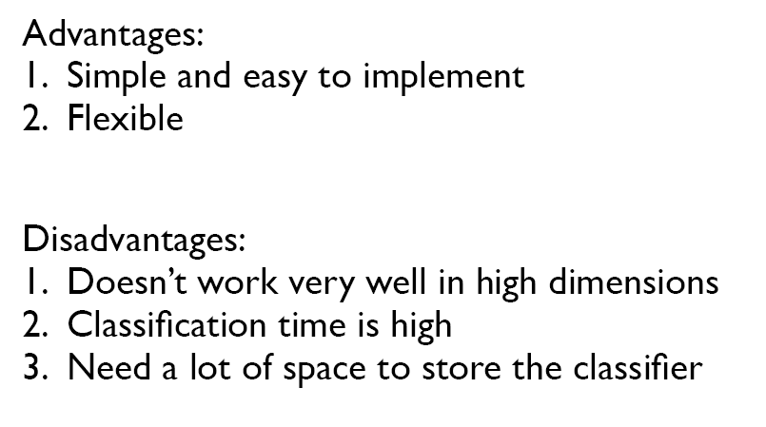
Instead of estimating the target function once for the entire data set
(which can lead to complex and not necessarily accurate functions)
IBL can estimate the required function locally and differently
for each new instance to be classified.
By taking the weighted average of the k neibhours nearest to the query point, it can smooth out the impact of isolated noisy training example.

Slide 16
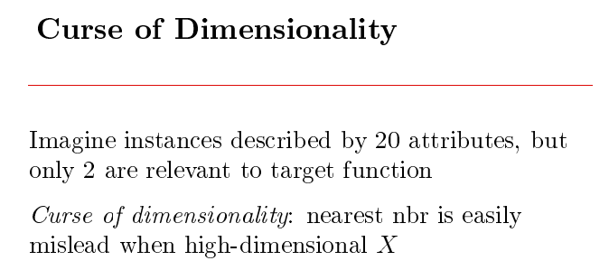
Decision trees
Use cross validation to overcome this problem

Slide 17
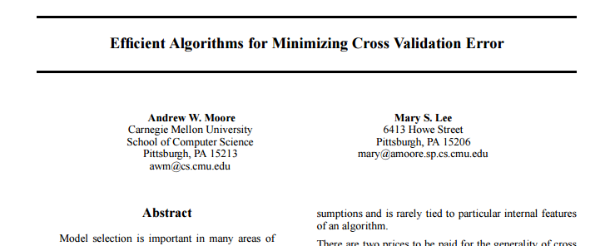
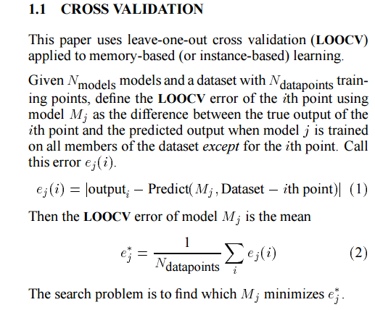
See page 235, last paragraph of Mitchell
https://pdfs.semanticscholar.org/352c/4ead66a8cf89b91f9de5ac86bc69f17b29d0.pdf

Slide 19

What is the inductive bias of Knn?

